Slide 1

ZOMATO CASE STUDY
Sales Decline
Analysis
Food Delivery Sales Inefficiency & Remediation Analysis
Role
Business Analyst
Prepared By Sairaj More
Date 26/06/2026

Slide 2

01 / Business Problem

Slide 3

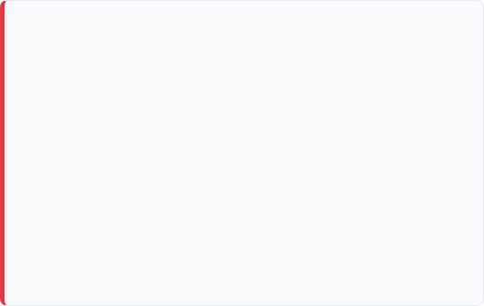
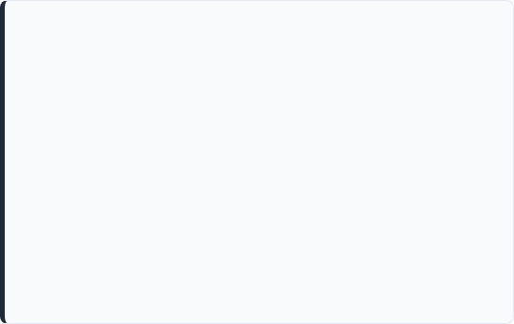

Business Problem & Scopes
Business Problem Overview
Scopes and Assumptions
Problem Statement:
SALES DECLINE
BUSINESS LINE
20%
Food Delivery
Zomato's Sales Declining Over the Last 6 Month's.
GEOGRAPHY
TIME PERIOD
Objective:
Mumbai
Last 6 Months
Find the Root Cause and Recommended Data Driven Solution.
TARGET CUSTOMER SEGMENT
Repeat Customer

Slide 4

Key Clarifications
Is the Decline in Sales, Revenue, Profit or Order?
Understanding the exact financial metric impacted to isolate the scope of the trend.
Is this Affecting all Cities or Only Specific Region?
Pinpointing regional patterns versus broad-level operational system shifts.
Which Business Line is Impacted?
Isolating Food Delivery from other verticals like Dining Out, Hyperpure, or Event Ticketing.
Which Customer Segment is Contributing to the Decline?
Detecting behavioral drift across new users versus loyal long-term cohorts.

Slide 5
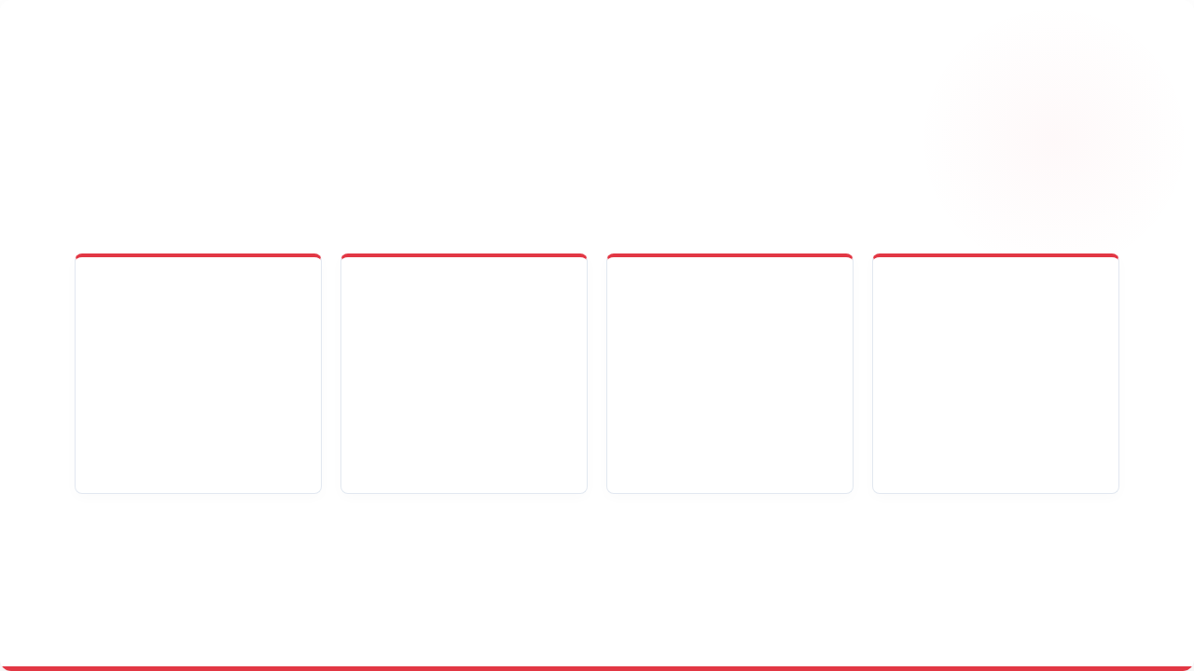






Key Success KPIs
Sales Revenue
Average Order Value by Customer
Customer Retention
Customer Churn
Primary KPI
Supporting KPI
Supporting KPI
Tracking high-level operational recovery & transaction totals.
Supporting KPI
Evaluating the rate of recurring usage within key cohorts.
Identifying the rate at which long-term customers drop off.
Monitoring ticket size adjustments per active transaction.

Slide 6
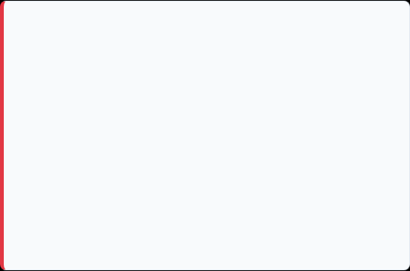
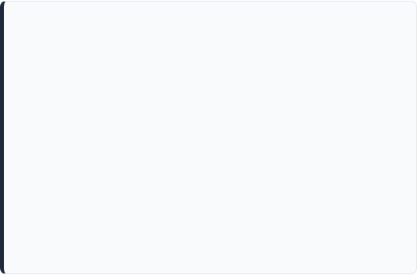
Problem Breakdown Factors
Internal Factors
External Factors
App Performance Issue (UI/UX design)
Other Market Competitors
Checkout Failures
Increasing Price / Price Sensitive Customer
Delivery Delays
Inflation
Order Cancellation
Fuel Price Increasing for Home Delivery
Customer Support Problem
Change Food Preferences
Higher Platform Fees
Seasonal Demand Pattern
Reduced Discounts

Slide 7
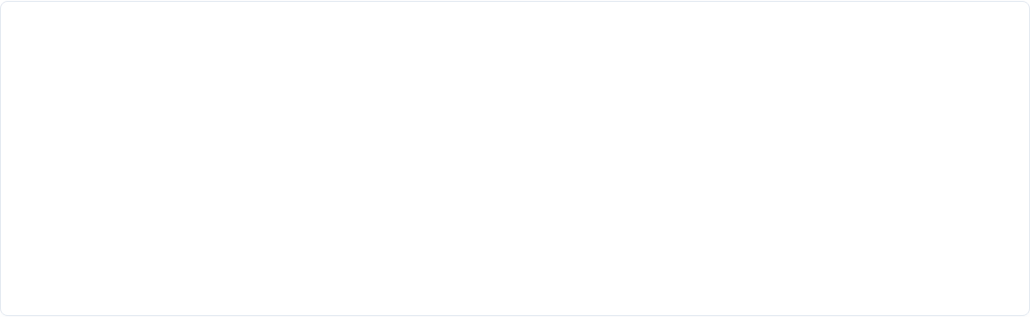
Hypothesis Foundation
Hypothesis | Validation Method
Delivery Time Increased | Delivery Time Report
Platform Fee Increased | Pricing Analysis
Customer Complaint Increased | Complaint Dashboard
Competitor Discount Improved | Market Research
Add Performance Degraded | Cash Report Analysis

Slide 8
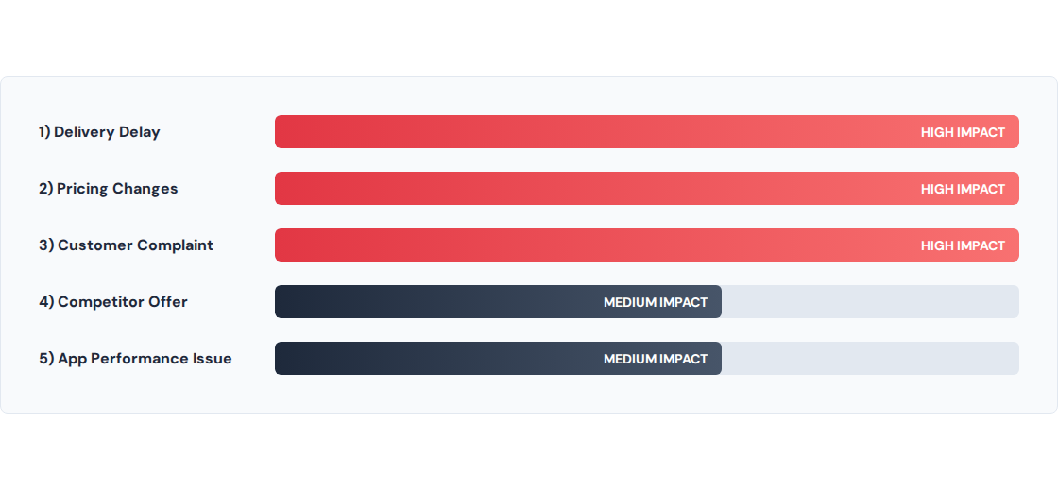
Prioritized Hypothesis Impact

Slide 9

Data & Stakeholder Alignment
Data Required | Associated Stakeholder
Sales and Revenue Report | Business Manager
Order Trends | Product Manager
Retention and Churn Data | Marketing Team
Delivery Time and Metrics | Operations Team
Complaint and Refund Reports | Customer Support
App Rating and Reviews | Technology Team
Competitor and Pricing Data | Restaurant Partner Team

Slide 10
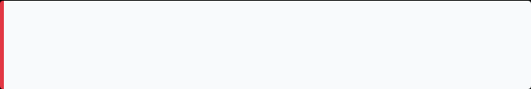

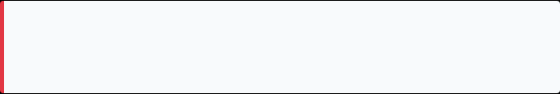
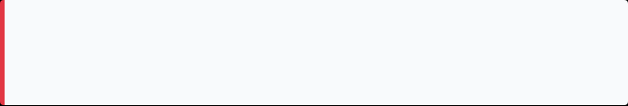
Findings & Root Cause Metrics
1) Delivery Performance Decline
28 to 42 minutes (Delivery Time Increased)
Resulted in operational bottleneck and overall drop in efficiency.
+50%
2) Customer Complaints
+35% Complaint Volume Increased
Highlights severe service quality concerns among active users.
SLOWER DELIVERY
3) Repeat Order Erosion
-18% Repeat Customer Orders Declined
Identifies that Zomato's highly loyal customers are ordering less frequently.

Slide 11





Root Cause Analysis: Why 5 Technique
Why Sales Declined? → Because Customers Ordered Less.
Why Customers Ordered Less? → Because Delivery was consistently Delayed.
Why Delivery was consistently Delayed? → Because of Insufficient delivery Partners during Peak hours.
Why Insufficient delivery Partners during Peak hours? → Because of a Low incentive Structure.
Why Low incentive Structure reduced partner Availability? → Operational bottleneck leading directly to the 20% sales decline.
Root Cause Validated
Operational Inefficiencies combined with increased competition led to lower Customer satisfaction and reduced repeat orders

Slide 12
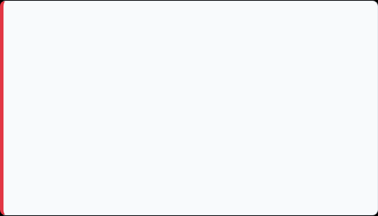
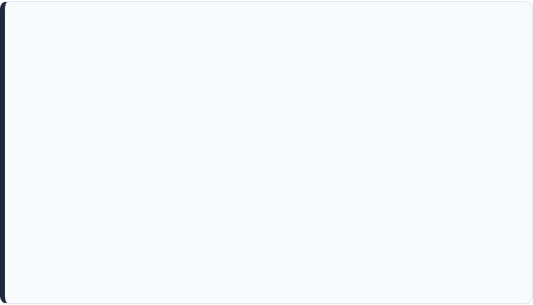
Recommended Solutions Roadmap
Tactical: 0 - 3 Months
Strategic: 3 - 12 Months
1) Increase delivery partner incentives
1) AI based Delivery Routing
2) Improve refund turnaround time
2) Restaurant Performance Monitoring
3) Targeted discounts for repeat customers
3) Pricing Strategy Redesign
4) Fix critical app issues
4) Strengthen loyalty Program
5) Launch Retention campaigns
5) Enhance App Scalability

Slide 13

Prioritization Matrix
Recommendations | Priority Level
Improve Delivery Operations | HIGH
Enhance Customer Support | HIGH
Fix App Performance | HIGH
Review Pricing Strategy | MEDIUM
Launch Loyalty Program | MEDIUM
Technology Enhancement | LOW

Slide 14
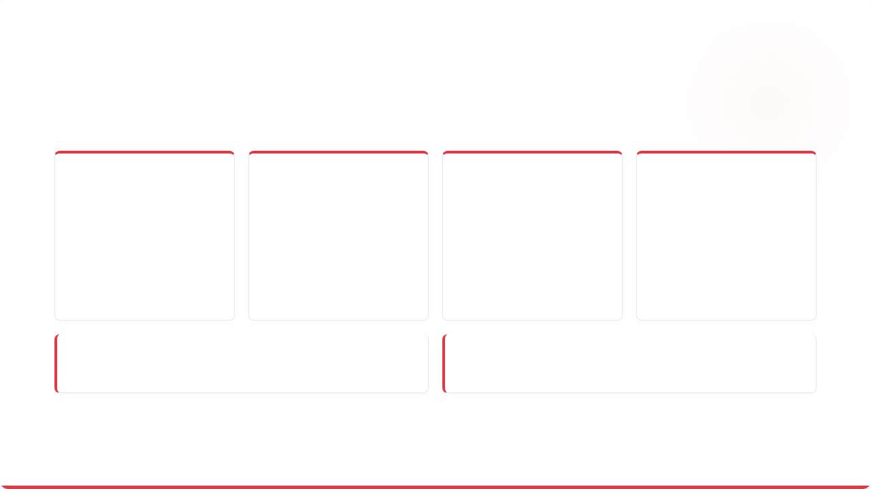
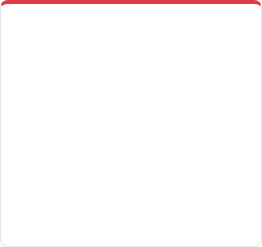







Success Metrics (KPIs)
Revenue
Orders
Retention
Delivery
Sales Growth
Order Count
Customer Retention
Delivery Time
Monthly Revenue Increases
Total Completed Orders
Repeat Customer Rate
Average Minutes Per Order
Support: Resolution Time
Experience: CSAT & NPS
Complaint Turnaround Time
Customer Satisfaction Score

Slide 15
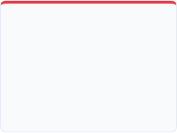
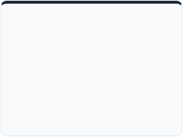
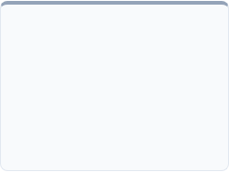
Monitoring & Continuous Improvement
Framework for systematic review and execution adjustments
1) OPERATIONAL
2) BUSINESS
3) ITERATIVE
Weekly Monitoring
Monthly Monitoring
Continuous Improvement
Delivery Time, Order Count, Complaints, App Performance
Revenue, Retention, Churn, Customer Satisfaction
Review KPI trends and implement iterative enhancement

